Slide 1


Capstone Project – Author Analysis

Slide 2
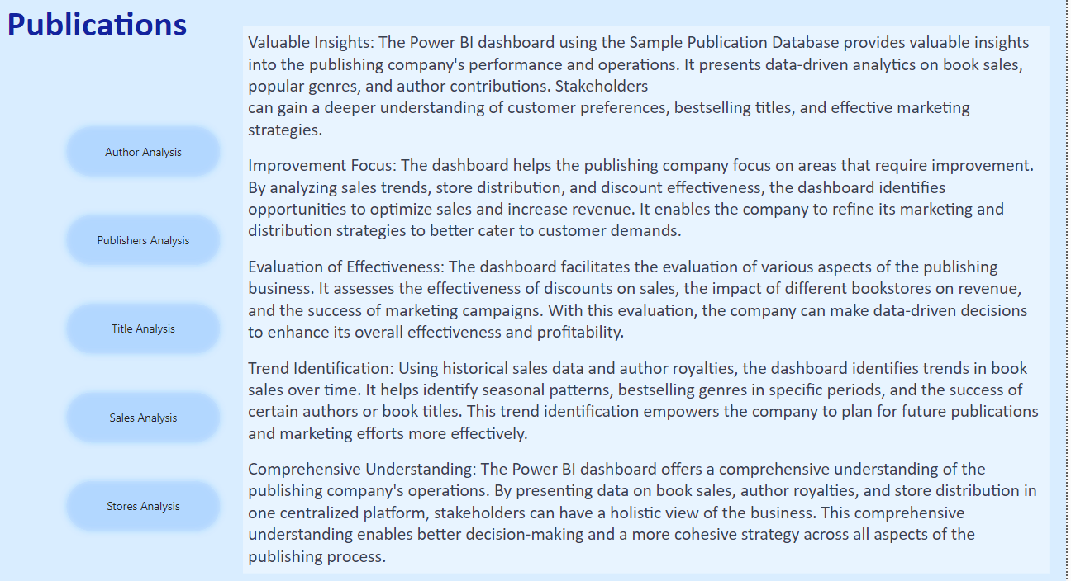
Table Explanation

Slide 3
Objective: The objective of this project is to create a comprehensive Power BI dashboard utilizing the Sample Publication Database. The dashboard aims to provide valuable insights into the publishing company's book sales performance, author royalties, and store distribution, enabling data-driven decision-making and strategic planning.
Analysis Scope: The analysis will focus on various aspects of the publication process, including book sales, author contributions, store performance, and the impact of discounts. It will encompass historical sales data, author royalties based on royalty schedules, and distribution data from multiple bookstores.
Goal: The primary goal of this Power BI dashboard is to offer a holistic view of the publishing company's operations. It will provide actionable insights to optimize book sales, enhance author collaboration, improve store distribution strategies, and identify opportunities for growth and efficiency.

Slide 4
Insights & Recommendations: The Power BI dashboard will generate valuable insights into the top-selling book titles, bestselling genres, and sales trends over time. It will analyze the performance of different bookstores, identify bestselling authors, and calculate author royalties based on royalty schedules. Additionally, it will recommend effective discount strategies to boost book sales and customer engagement.
Report & Presentation: The final deliverable will consist of a detailed report describing the data sources, data modeling methodologies, and data cleansing processes used in creating the Power BI dashboard. The report will also include a step-by-step guide on how to interpret the insights and use the dashboard for decision-making. The presentation will showcase the key findings, visualizations, and actionable recommendations derived from the dashboard's analysis.
The Power BI dashboard, along with the report and presentation, will serve as a powerful tool for the publishing company's stakeholders. It will empower them to make informed decisions, optimize book sales strategies, foster author collaborations, and enhance the overall business performance in the competitive publishing landscape.

Slide 5
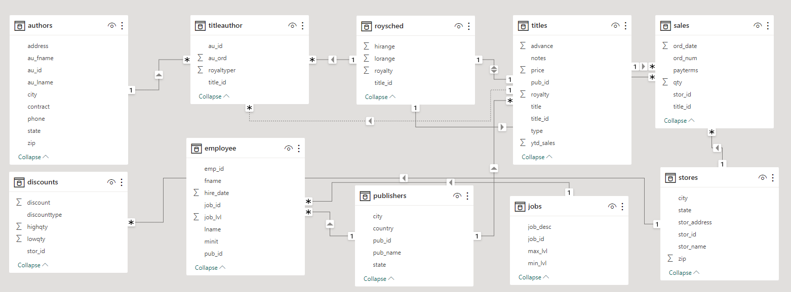
ER Diagram

Slide 6

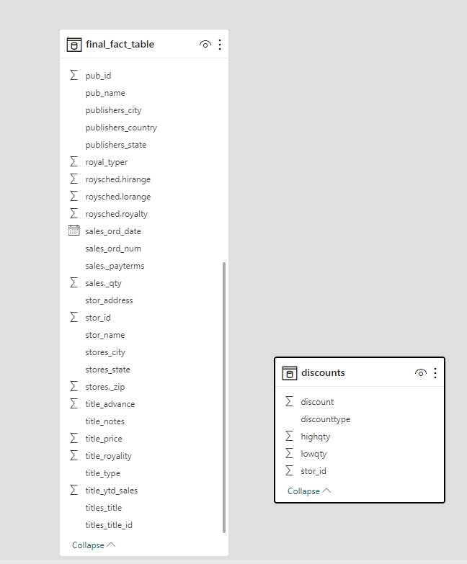

Slide 7
Power BI Problem Statements

Slide 8
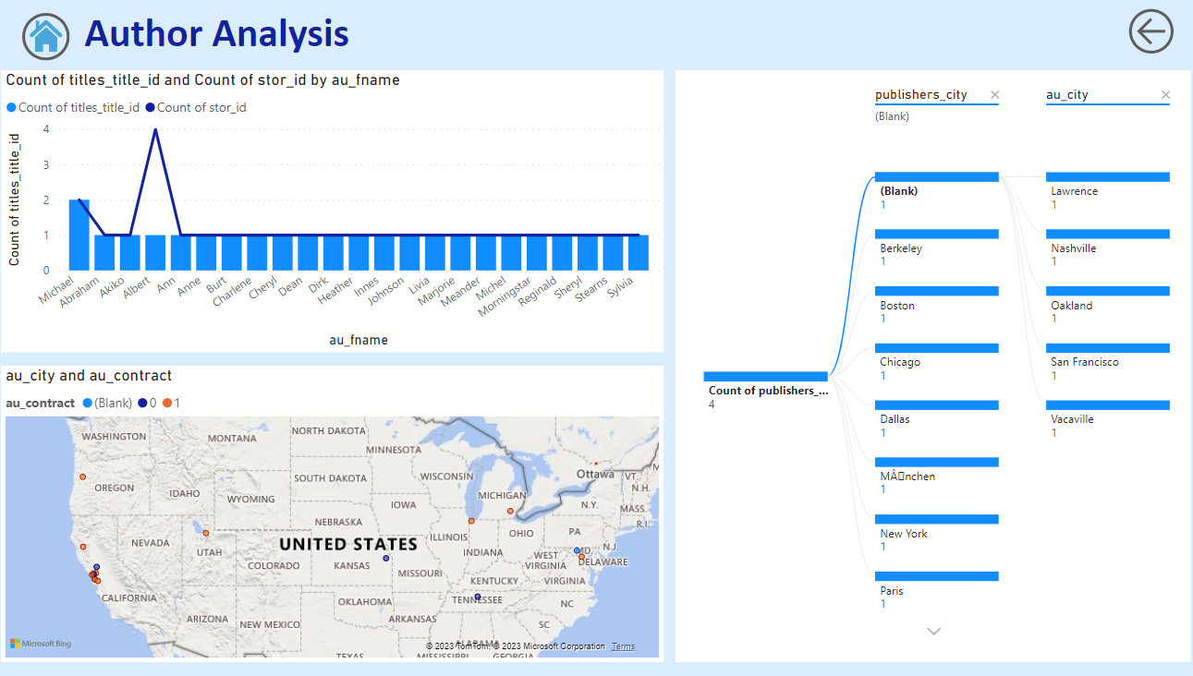

Slide 9
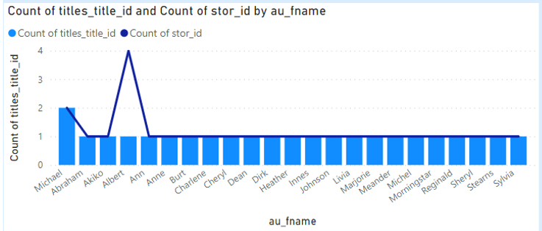
How many universities are there in each country?
Gleaning from the Country Report, it becomes apparent that nations such as the USA, China, and Japan boast the highest number of universities. Conversely, countries like Uganda, the UAE, and Uruguay exhibit a comparatively lower count of universities.

Slide 10

How many universities are there in each country?
Gleaning from the Country Report, it becomes apparent that nations such as the USA, China, and Japan boast the highest number of universities. Conversely, countries like Uganda, the UAE, and Uruguay exhibit a comparatively lower count of universities.

Slide 11
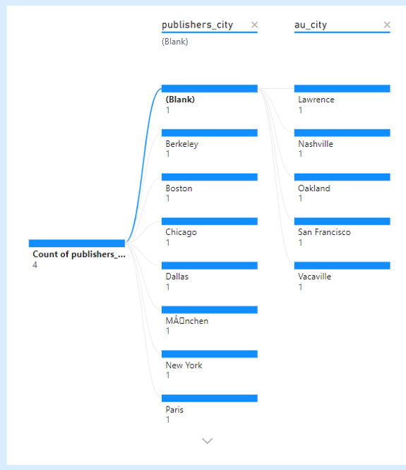
How many universities are there in each country?
Gleaning from the Country Report, it becomes apparent that nations such as the USA, China, and Japan boast the highest number of universities. Conversely, countries like Uganda, the UAE, and Uruguay exhibit a comparatively lower count of universities.

Slide 12
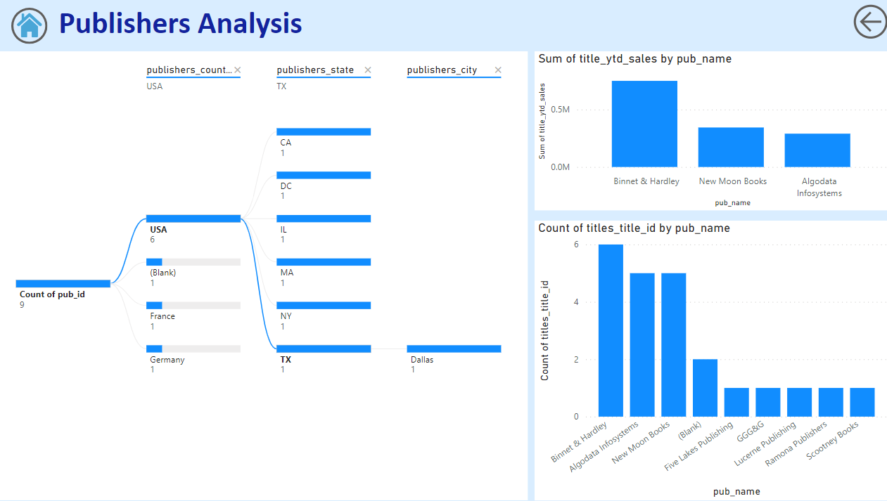

Slide 13
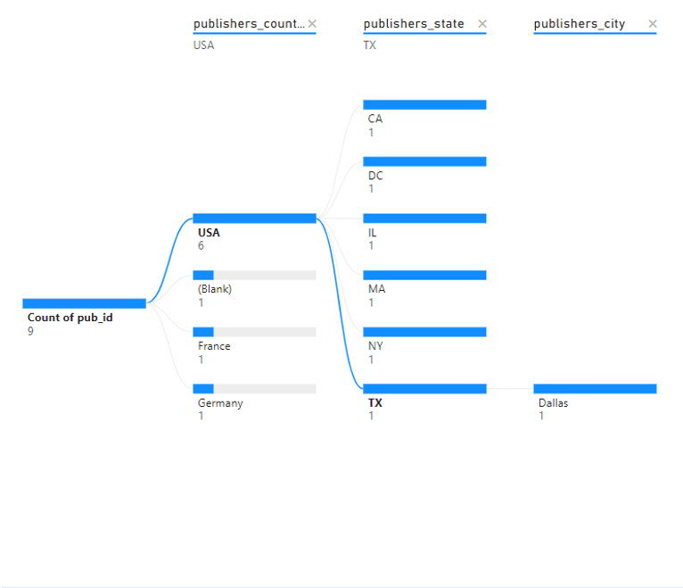
How many universities are there in each country?
Gleaning from the Country Report, it becomes apparent that nations such as the USA, China, and Japan boast the highest number of universities. Conversely, countries like Uganda, the UAE, and Uruguay exhibit a comparatively lower count of universities.

Slide 14
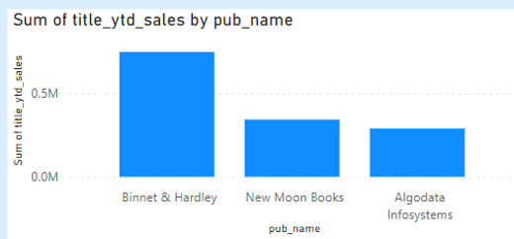
How many universities are there in each country?
Gleaning from the Country Report, it becomes apparent that nations such as the USA, China, and Japan boast the highest number of universities. Conversely, countries like Uganda, the UAE, and Uruguay exhibit a comparatively lower count of universities.

Slide 15
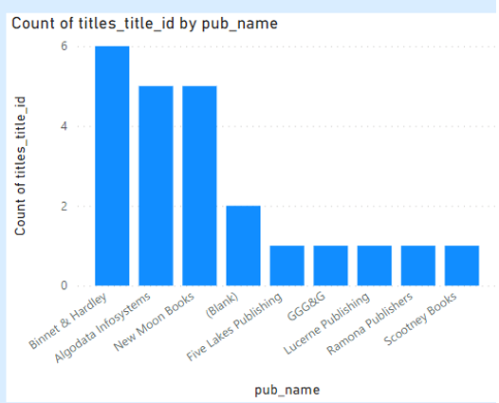
How many universities are there in each country?
Gleaning from the Country Report, it becomes apparent that nations such as the USA, China, and Japan boast the highest number of universities. Conversely, countries like Uganda, the UAE, and Uruguay exhibit a comparatively lower count of universities.

Slide 16
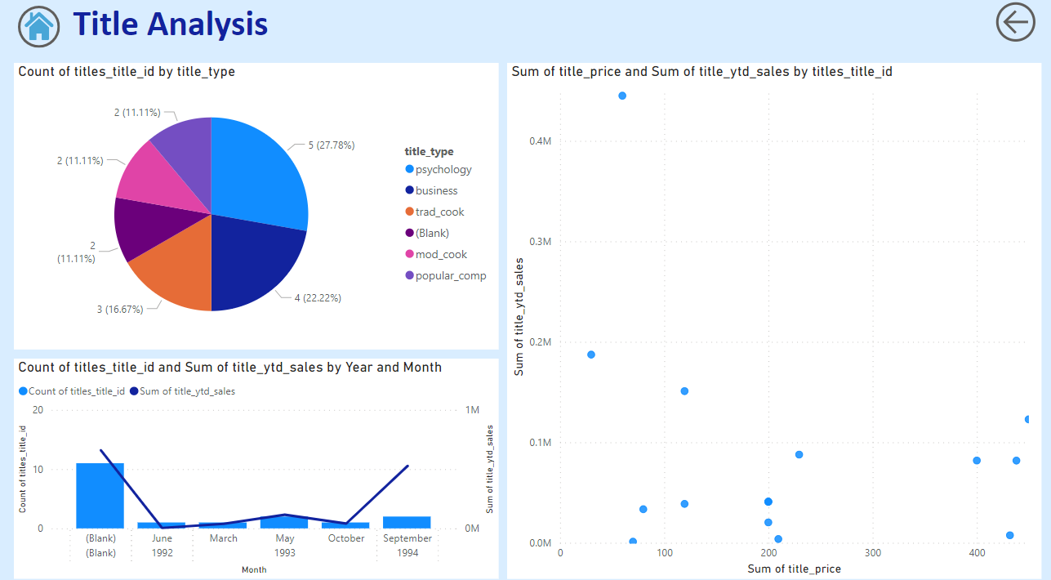

Slide 17
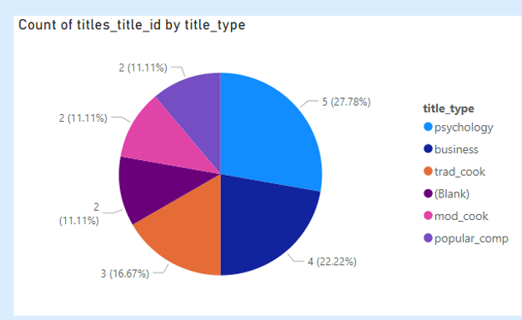
How many universities are there in each country?
Gleaning from the Country Report, it becomes apparent that nations such as the USA, China, and Japan boast the highest number of universities. Conversely, countries like Uganda, the UAE, and Uruguay exhibit a comparatively lower count of universities.

Slide 18
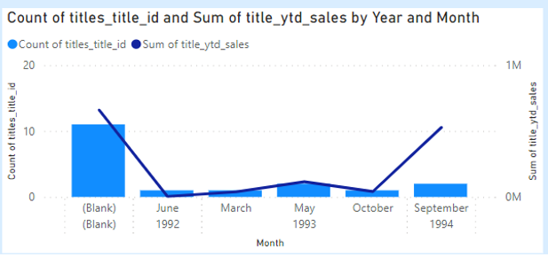
How many universities are there in each country?
Gleaning from the Country Report, it becomes apparent that nations such as the USA, China, and Japan boast the highest number of universities. Conversely, countries like Uganda, the UAE, and Uruguay exhibit a comparatively lower count of universities.

Slide 19
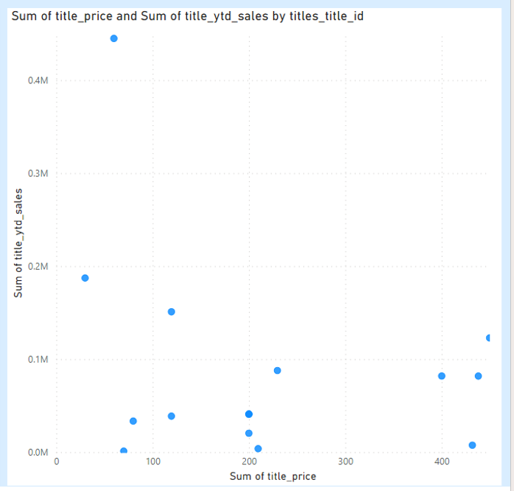
How many universities are there in each country?
Gleaning from the Country Report, it becomes apparent that nations such as the USA, China, and Japan boast the highest number of universities. Conversely, countries like Uganda, the UAE, and Uruguay exhibit a comparatively lower count of universities.

Slide 20
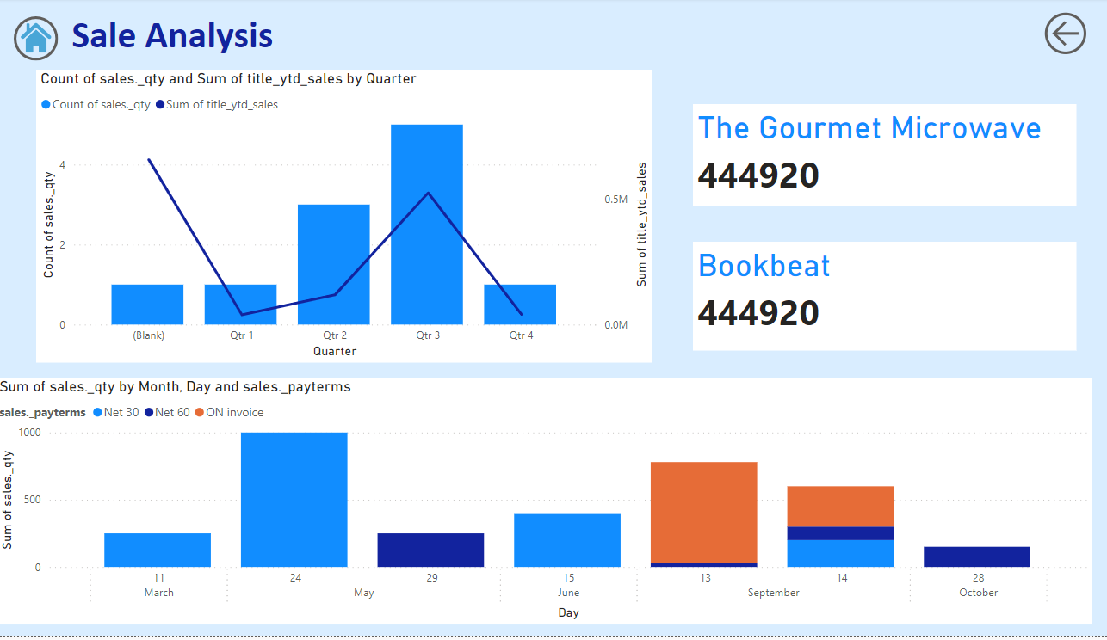

Slide 21
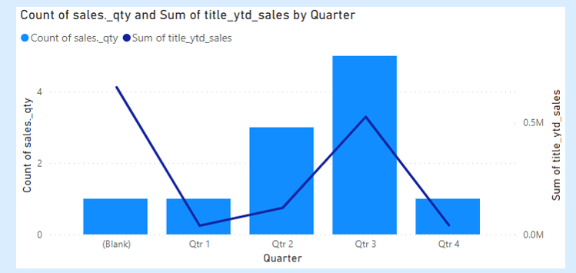
How many universities are there in each country?
Gleaning from the Country Report, it becomes apparent that nations such as the USA, China, and Japan boast the highest number of universities. Conversely, countries like Uganda, the UAE, and Uruguay exhibit a comparatively lower count of universities.

Slide 22

How many universities are there in each country?
Gleaning from the Country Report, it becomes apparent that nations such as the USA, China, and Japan boast the highest number of universities. Conversely, countries like Uganda, the UAE, and Uruguay exhibit a comparatively lower count of universities.

Slide 23
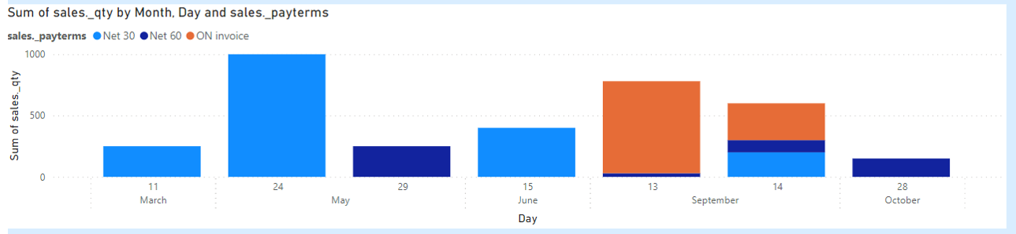
How many universities are there in each country?
Gleaning from the Country Report, it becomes apparent that nations such as the USA, China, and Japan boast the highest number of universities. Conversely, countries like Uganda, the UAE, and Uruguay exhibit a comparatively lower count of universities.

Slide 24
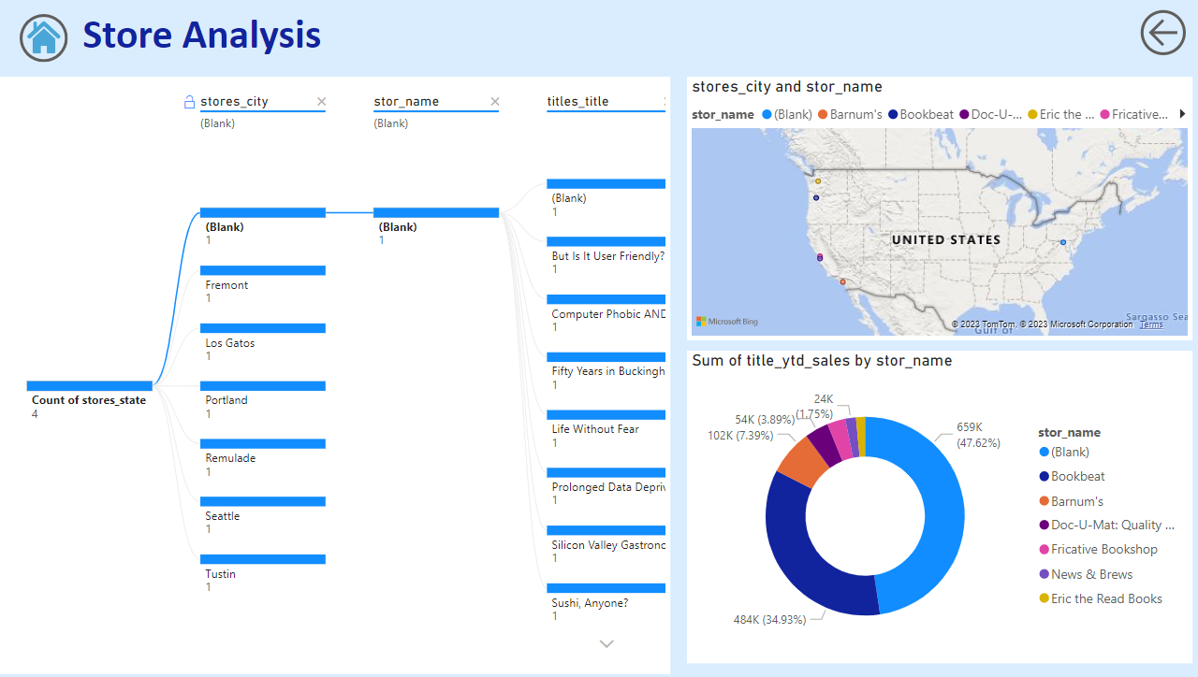

Slide 25
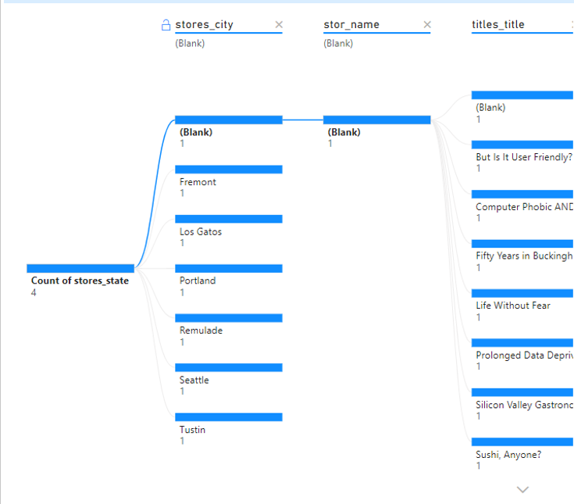
How many universities are there in each country?
Gleaning from the Country Report, it becomes apparent that nations such as the USA, China, and Japan boast the highest number of universities. Conversely, countries like Uganda, the UAE, and Uruguay exhibit a comparatively lower count of universities.

Slide 26

How many universities are there in each country?
Gleaning from the Country Report, it becomes apparent that nations such as the USA, China, and Japan boast the highest number of universities. Conversely, countries like Uganda, the UAE, and Uruguay exhibit a comparatively lower count of universities.

Slide 27
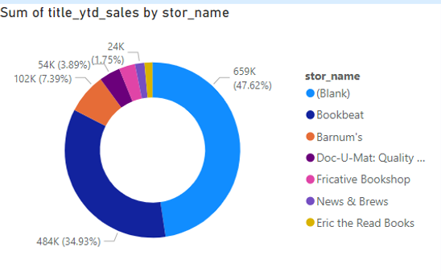
How many universities are there in each country?
Gleaning from the Country Report, it becomes apparent that nations such as the USA, China, and Japan boast the highest number of universities. Conversely, countries like Uganda, the UAE, and Uruguay exhibit a comparatively lower count of universities.

Slide 28
EDA Problem Statements

Slide 29
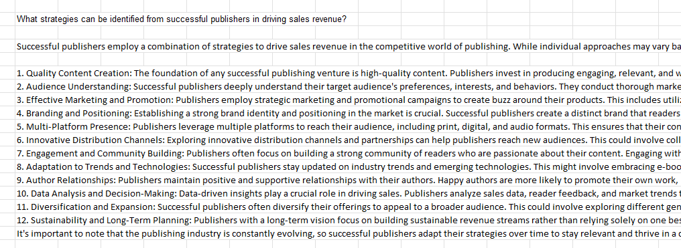

Slide 30
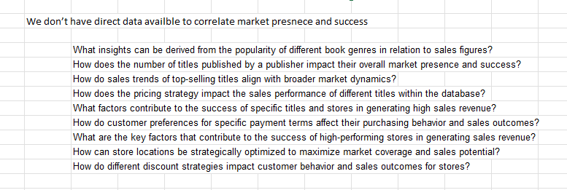

Slide 31
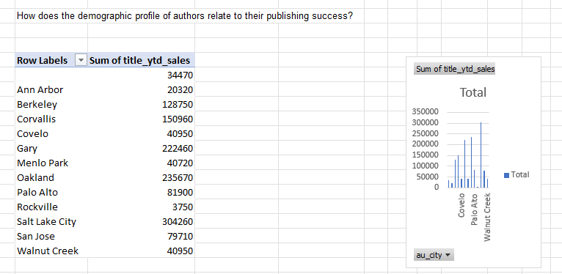

Slide 32
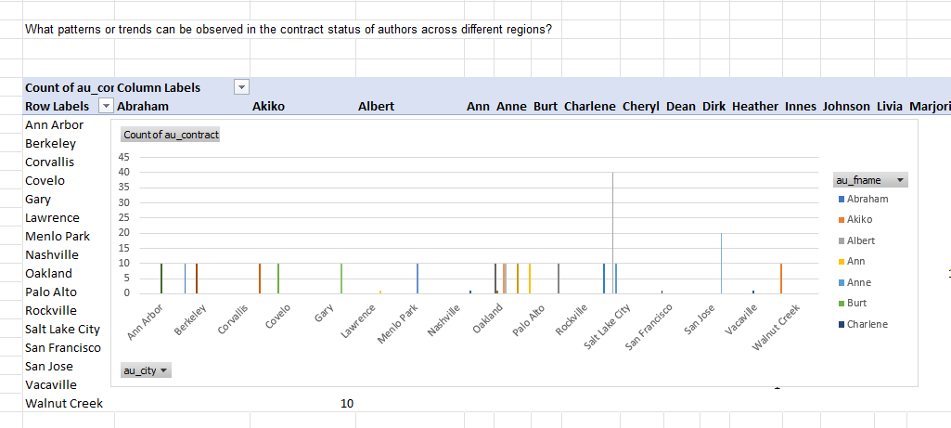

Slide 33
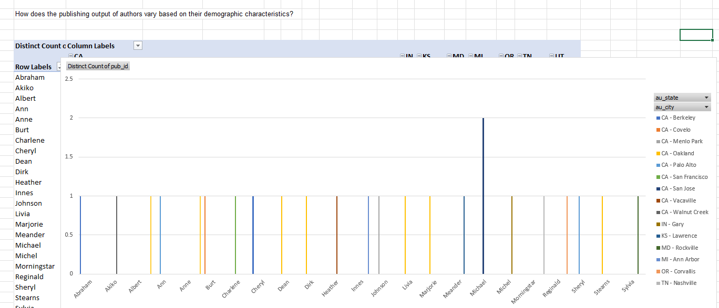

Slide 34
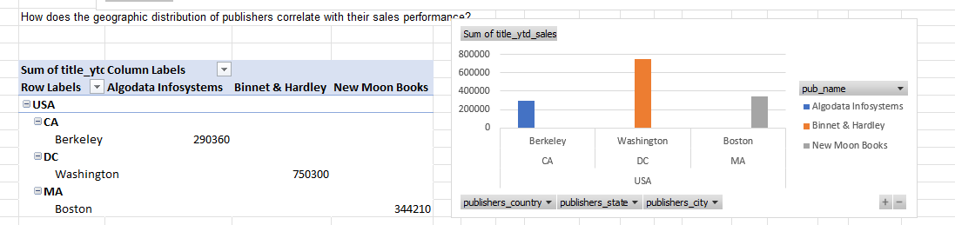

Slide 35
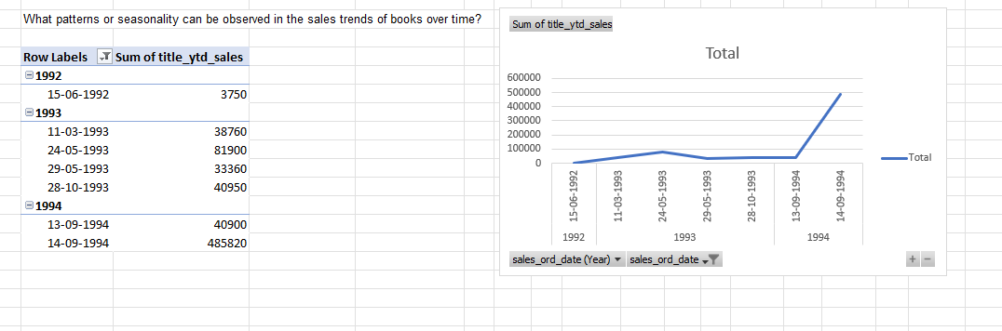

Slide 36
University rankings analysis can provide valuable insights for prospective students, researchers, and academic institutions to make informed decisions. By understanding the factors that influence university rankings, individuals and institutions can make better choices about where to study or work. Understanding ranking criteria can help institutions identify areas for improvement. By understanding what is important to ranking organizations, institutions can focus their efforts on those areas to improve their ranking. Analysis of university rankings can allow policymakers to assess the effectiveness of ranking systems. By understanding how rankings are calculated, policymakers can make sure that they are fair and accurate. Historical analysis of university rankings can identify trends for benchmarking and strategic planning in higher education. By understanding how rankings have changed over time, institutions can identify areas where they need to improve to stay competitive. Analysis of university rankings can enable comparisons between institutions and data-driven decisions for improving higher education quality and competitiveness. By comparing different institutions, institutions can identify the best practices that can be adopted to improve their own performance.

